Slide 1
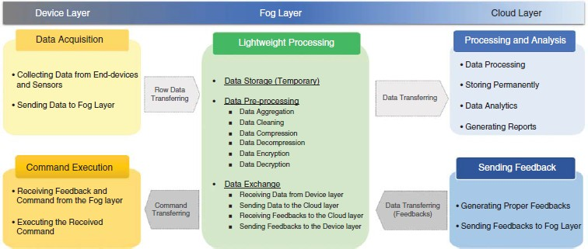
FOG DATA MANAGEMENT
Data life cycle and fog data characteristics as the essential concepts of fog data Management
A. Fog Data Life Cycle
The fog data life cycle consists of 5 main steps data acquisition, lightweight processing, processing and analysis, study feedback, and command execution

Slide 2
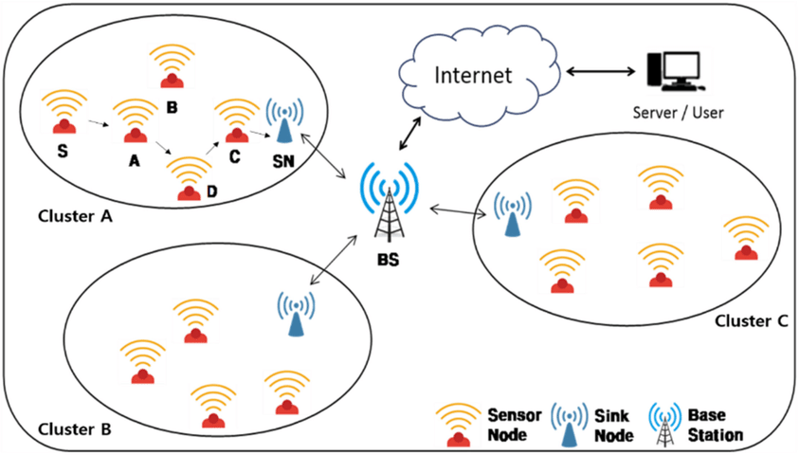
i) Data Acquisition
Data from different types of end devices should be acquired.
It must be sent to upper layers.
To this end, a sink node or local gateway node may exist to gather data, or sensors can send data directly to the fog.

Slide 3
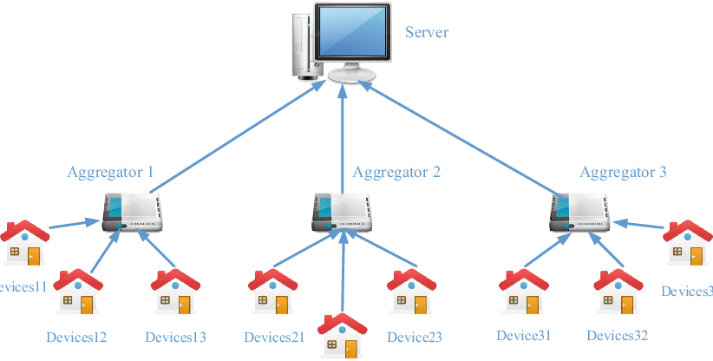
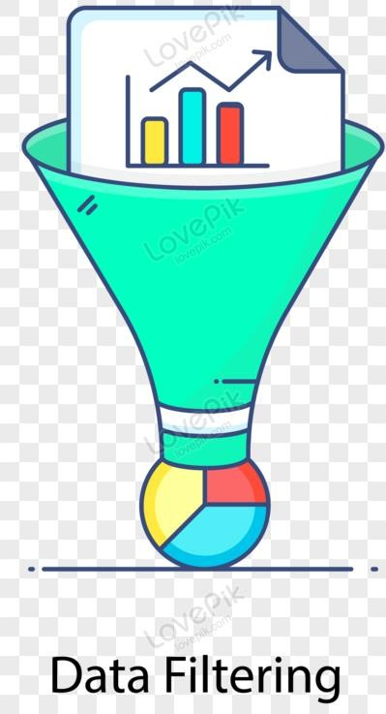
ii) Lightweight Processing
This step provides lightweight data manipulation and local
processing on the collected data.
Lightweight processing may include
data aggregation
data filtering, elimination of unnecessary or repetitive data
data cleaning
compression/ decompression
some lightweight data analysis and pattern extraction
data

Slide 4
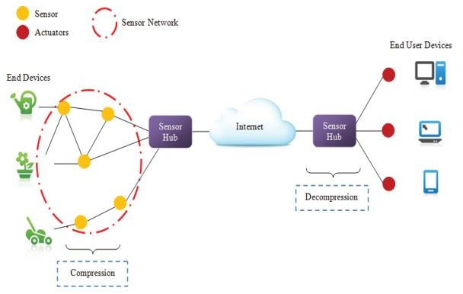
The aggregated data will be transferred to the cloud via the network.
In addition, the feedback as response data should be transferred to the
device.
Also, as the feedback is received from cloud layer and sent to the device layer, there may be a need for data decompression, data decryption, doing some format change on the received data, etc.

Slide 5
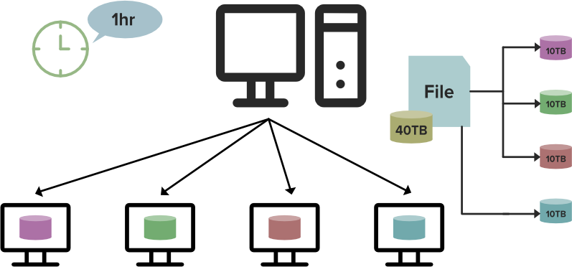
iii) Processing and Analysis
Received data may be stored permanently in the cloud layer, and it is processed based on predefined requirements.
The application users may access data to get reports or data analysis.
Different types of analysis on stored data may be applied to obtain valuable information and knowledge, and these types of processing and analysis are almost in the scale of big data.
They need big data platforms and technologies such as HDFS for storage
and map-reduce for processing

Slide 6
iv) Sending Feedback
Based on data processing and analyzing, feedbacks such as proper
commands or decisions are generated and sent to the fog layer.
v) Command Execution
Actuators must run the proper action based on the received data.
In this way, proper feedback and responses are applied
to the
environment.

Slide 7
B. Data Characteristics
Reviewing data characteristics is necessary to define and refine data quality and integration standards and to handle the related challenges properly in the data management process.
Data quality refers to how much data characteristics are suitable and
can meet the terms with consumer requirements.
The main IoT data characteristics are as follow:
Uncertainties
Erroneous
Noisy data
Voluminous and distributed
Smooth variation
Continuous correlation
Periodicity
Markovian behavior

Slide 8
Data quality dimensions reviewed are
Accuracy
Confidence
Completeness
Data volume
Timeliness
Three other additional data quality dimensions are
Ease of access,
Access security
Interpretability
IoT data characteristics were categorized into three categories:
Data generation
Data quality
Data interoperability.
The IoT data quality characteristics include
Uncertainty
Redundancy
Ambiguity
Inconsistency.

Slide 9
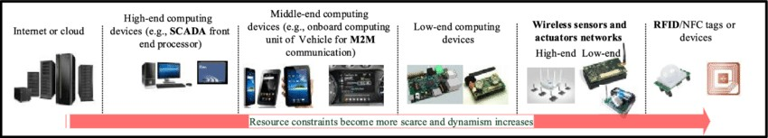
Management of main IoT data characteristics and the related issues can be done in the fog data management process to fulfill the requirements.
In the following, these characteristics are reviewed:
Heterogeneity.
– Distributed heterogeneous end devices generate data in different formats.
– Generated data may be diversely varying in terms of structure or
format.
Inaccuracy.
Inaccuracy or uncertainties of the sensed data refer to the sensing
precision, accuracy, or misreading of data.
Inconsistency.
Low precision or misreading in the sensed data may cause
inconsistency in the gathered data.

Slide 10
Weak semantics
The collected raw data that may be heterogeneous in terms of data formats, data structure, data source, etc. must be processed and managed.
Using the concepts of semantic web and injecting some information and extra data to the raw data make the data readable and understandable for machines.
Most of the collected data from the environment has weak semantics
Velocity
Data generation rates and sampling frequencies are varying in different types of end devices.
Redundancy.
Repetitive data that are sent by one or more end devices lead to
redundancy in the collected data.
Scalability.
Large numbers of end devices and high data sampling rate that may exist in different scenarios may lead to generation of a huge amount of data.

Slide 11
C. Data Pre-Processing and Analytics
i) Data Cleaning
Cleaning mechanisms can be applied on the collected data in fog layers to reduce the effect of dirty and unreliable data, and to increase the quality of them.
Data cleaning approaches can be divided in two categories:
Declarative data cleaning
Model-based data cleaning
Declarative data cleaning
High-level declarative queries such as CQL (Continuous Query Language) are used to define the sensor values constraints.
The user can express the queries and control the system easily via the
provided interface.
Extensible sensor stream processing (ESP), is a declarative-based and pipelined framework for sensor data cleaning for use in pervasive applications.

Slide 12
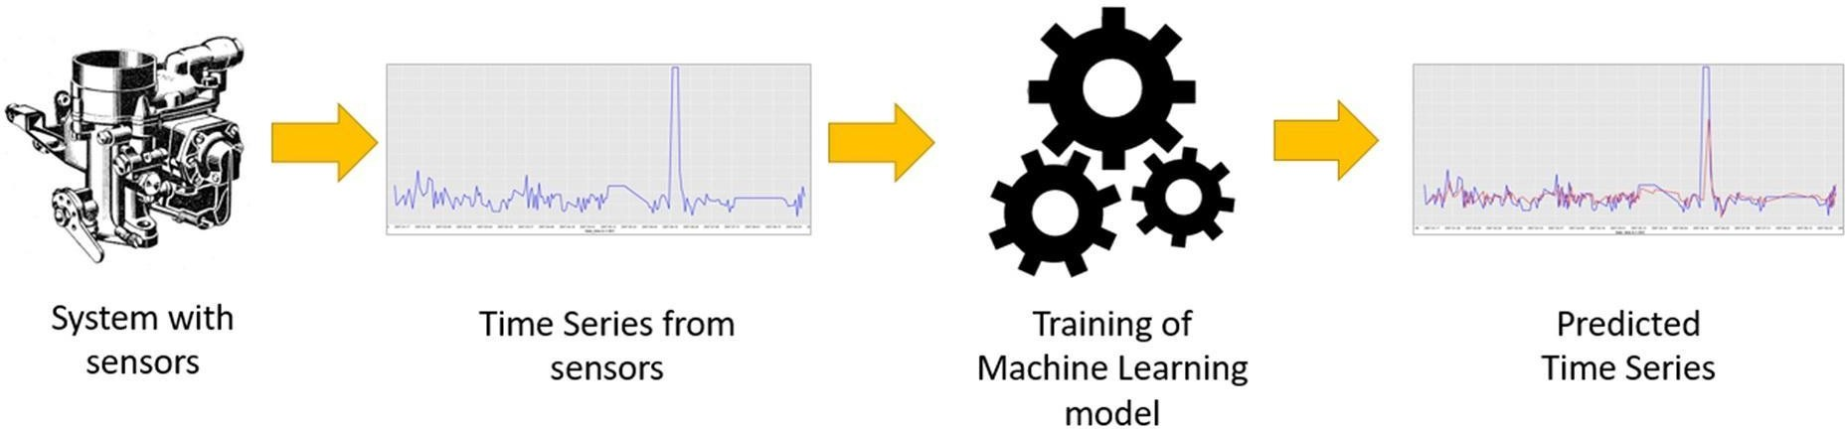
Model-based data cleaning.
Anomalies are detected by comparison of raw values with the inferred values that are resulted as the most probable values based on selected models.
The model-based approaches also have subcategories such as
regression models
Polynomial regression
Chebyshev regression
probabilistic models
Kalman filters
Outliner detection models

Slide 13

ii) Data Fusion
Data fusion refers to the elimination of redundant and ambiguous data and integration of data, and can be done in the fog layer as one of the data management tasks to increase the accuracy and efficiency.
Data fusion models can be categorized into three particular categories:
Data-based model
Activity-based model
Role-based model
Khaleghi et al. categorizes data fusion frameworks into four classes based on data-related aspects:
imperfect data fusion framework
Related to data imperfection, which is one the main data challenges and
caused by impreciseness, incompleteness, vagueness, or uncertainty
correlated data fusion framework
Related to dependency of data.
inconsistent data fusion framework
Conflict of data
disparate data fusion framework
Diversity on data

Slide 14
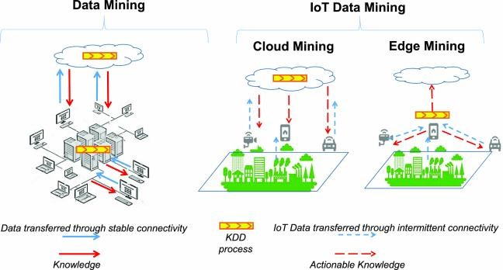
iii) Edge Mining
Fog computing can be effective for local analytics and stream processing
to reduce the volume of data.
Edge mining refers to utilize mining approaches on raw data that are produced by devices in the edge of the network (fog layer).
The size of the transferred data will be reduced and better energy savings
can be achieved.

Slide 15
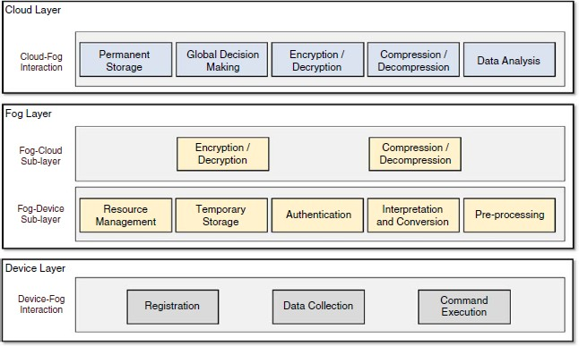
D. Proposed Architecture
A conceptual architecture based on the three-layer model to handle
data management issues is shown below

Slide 16
1. Device Layer
Modules of the device layer are registration module, data collection
module, and command execution module.
Registration.
Physical devices can join to the network or leave it dynamically via this module.
Registration is necessary for sending and receiving messages.
Registration requests as an initial message should be sent by the device to the fog layer.
Through the registration process, devices get a unique ID and key
that should be attached in the messages for authentication process.
Data Collection/Command Execution.
Registered sensors collect data to transfer to the fog layer.
Actuators are responsible for running the received commands from the fog layer by this module.

Slide 17
2. Fog Layer
Resource Management
The fog layer receives the join requests that are sent by the device layer.
The resource management module queries the list of devices and adds the device specifications to the list in case of absence or deactivation of device, and it will be added.
Based on fog applications policy, registered devices that are not
sending message for a predefined period may be deactivated.
Temporary Storage
Temporary storage can be a module to store some of the incoming data or intermediate computation results, for further processing in a database.
It also stores specifications of registered devices and their IDs and
keys for authentication process.

Slide 18
Authentication.
The authentication module searches the list of registered devices on temporary storage to find related key and ID to authenticate the incoming messages.
Interpretation and Conversion.
The communication of devices and fog may be receiving data, as well as there may be possible heterogeneity in terms of communication types between devices and the fog layer, so data may be sent via different technologies such as Wi-Fi, Bluetooth, ZigBee, RFID, or etc.
Therefore, Interpretation and conversion provides different protocols
and conversion methods.
Pre-Processing
Storing the received data in the temporary storage, preparing and aggregating them are the responsibilities for the pre-processing module.

Slide 19
Some kinds of data processing may be needed on the
received data, such as data cleaning, data fusion, edge mining,
quality improvement of received signals by data filtering or de- noising them
decision making in case of emergency situations by checking and comparing the received or collected data against the predefined threshold and conditions
Encryption/Decryption.
To improve data privacy and protect sensitive data in the message, encryption and decryption algorithms are provided in this module.
Compression/Decompression.
Compression techniques can be applied on the packet size of data to reduce overhead of networks.

Slide 20
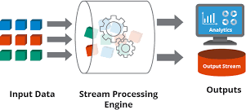
3. Cloud Layer
Permanent Storage
This module receives data from different fog zones and stores the
data in permanent storage.
Depending on the fog application type, the size of permanent storage might vary from gigabytes to even petabytes.
Big data technologies are applied in this layer to store data.
Global Decision-Making
Received data are processed to send proper feedback to the lower layers and to store the needed and useful data in permanent storage.
In case of receiving/sending compressed or encrypted messages from fog layer, decompression or decryption units are used, respectively.
Data in motion and data stream processing are the other issues raised in IoT and fog computing for some kinds of applications.

Slide 21
Encryption/Decryption, Compression/Decompression.
For privacy and efficiency concerns and to support encryption and compression, these modules must be located in both the cloud and fog layers.
Encryption and compression approaches must be agreed by both of
them.
Data Analysis.
Gathering of data will be very valuable when it leads to knowledge, so data analysis, pattern recognition, and knowledge discovery from the heterogeneous data that are collected from different devices are considered an important stage in the data life cycle.
This module is responsible for data analysis based on the application user requests for providing reports and getting global analysis on the gathered data.
Depending on the size of stored data in data storage, data analysis approaches and technologies may vary.
In the case of large-scale data storage, big data analytics technologies
may be applied.

Slide 22
FOG AND EDGE COMPUTING

Slide 23
RESTful API
RESTful API, or Representational State Transfer API, is a type of application programming interface (API) that allows two computer systems to communicate securely over the internet

Slide 24
RESTful APIs have several advantages
Flexibility: REST APIs can handle multiple types of calls, return different data formats, and change structurally.
Scalability: RESTful APIs are designed to handle many concurrent requests.
Security: RESTful APIs can be secured using standard security protocols like HTTPS.
Interoperability: RESTful APIs follow a uniform architecture, making them highly interoperable.
Simplicity: RESTful APIs are designed to be simple and easy to understand.
Efficiency: REST uses less bandwidth, making it more efficient in internet use.
RESTful APIs use HTTP requests to access and use data. They communicate through HTTP requests to perform standard database functions like creating, reading, updating, and deleting records (CRUD)

Slide 25
By using these methods (POST, GET, PUT, and DELETE), you can effectively create, read, update, and delete resources on the server, making RESTful APIs versatile and powerful for managing data.

Slide 26
RESTful API
RESTful APIs are essential for enabling communication between IoT devices, fog nodes, and edge computing systems. Here’s how you can design a RESTful API for fog and edge middleware:
1. API Endpoints
2. Security
3. Performance Metrics
4. Example Use Case

Slide 27
1. API Endpoints
POST is for sending data to the server to create something new, while GET is for fetching data from the server.
Device Management:
POST /devices - Register new devices.
GET /devices - Retrieve a list of registered devices.
PUT /devices/{id} - Update device information.
DELETE /devices/{id} - Remove a device.
Data Collection:
POST /data - Submit data from IoT devices.
GET /data - Retrieve collected data.
Edge Processing:
POST /processing - Submit data for local processing.
GET /processing - Retrieve processed data.
Alerts:
POST /alerts - Send alerts for critical conditions.
GET /alerts - Retrieve alert history.

Slide 28
2.Security
Authentication: Use OAuth 2.0 for secure access control.
Authorization: Implement role-based access control (RBAC) to manage permissions.
Data Encryption: Ensure data is encrypted during transmission using HTTPS.
OAuth 2.0 is an authorization framework that allows applications to obtain limited access to user accounts on an HTTP service, such as Facebook, GitHub, or Google. It enables users to grant third party applications access to their resources without sharing their credentials

Slide 29
3. Performance Metrics
Latency: Measure the time taken for requests and responses.
Throughput: Evaluate the number of requests handled per unit time.
Reliability: Track the consistency and dependability of the API.
Scalability: Assess the ability to handle an increasing number of devices and requests.

Slide 30
4. Example Use Cases
1. Smart Agriculture: IoT devices collect soil moisture data and send it to the fog node via the RESTful API. The fog node processes the data and sends alerts if irrigation is needed.
2. Smart Cities
Traffic Management: IoT sensors embedded in roads and traffic lights collect real-time traffic data. Fog nodes process this data locally to optimize traffic flow, reduce congestion, and minimize delays. RESTful APIs facilitate communication between sensors, fog nodes, and city control centers, enabling dynamic traffic signal adjustments and immediate rerouting suggestions.
3. Healthcare
Patient Monitoring: Wearable health devices monitor patients' vital signs (e.g., heart rate, blood pressure). Fog nodes near patients' locations process this data in real-time, triggering alerts if abnormal readings are detected. RESTful APIs handle data transmission, ensuring secure and efficient communication between devices, fog nodes, and healthcare providers, enabling timely medical intervention.
4. Industrial IoT (IIoT)
Predictive Maintenance: IoT sensors attached to industrial machinery collect data on equipment performance. Fog nodes analyze this data to predict potential failures and schedule maintenance before breakdowns occur. RESTful APIs manage the flow of data between sensors, fog nodes, and central systems, reducing downtime and maintenance costs.
5. Retail
Smart Inventory Management: IoT sensors track product levels on shelves and in storage areas. Fog nodes process this data to ensure timely restocking and avoid overstocking. RESTful APIs facilitate data exchange between sensors, fog nodes, and inventory management systems, optimizing stock levels and improving operational efficiency.
6. Environmental Monitoring
Air Quality Monitoring: IoT sensors monitor air quality parameters like CO2 and particulate matter levels. Fog nodes process this data to detect pollution hotspots and send alerts if air quality deteriorates. RESTful APIs connect sensors, fog nodes, and environmental monitoring systems, enabling real-time data analysis and timely response measures.

Slide 31
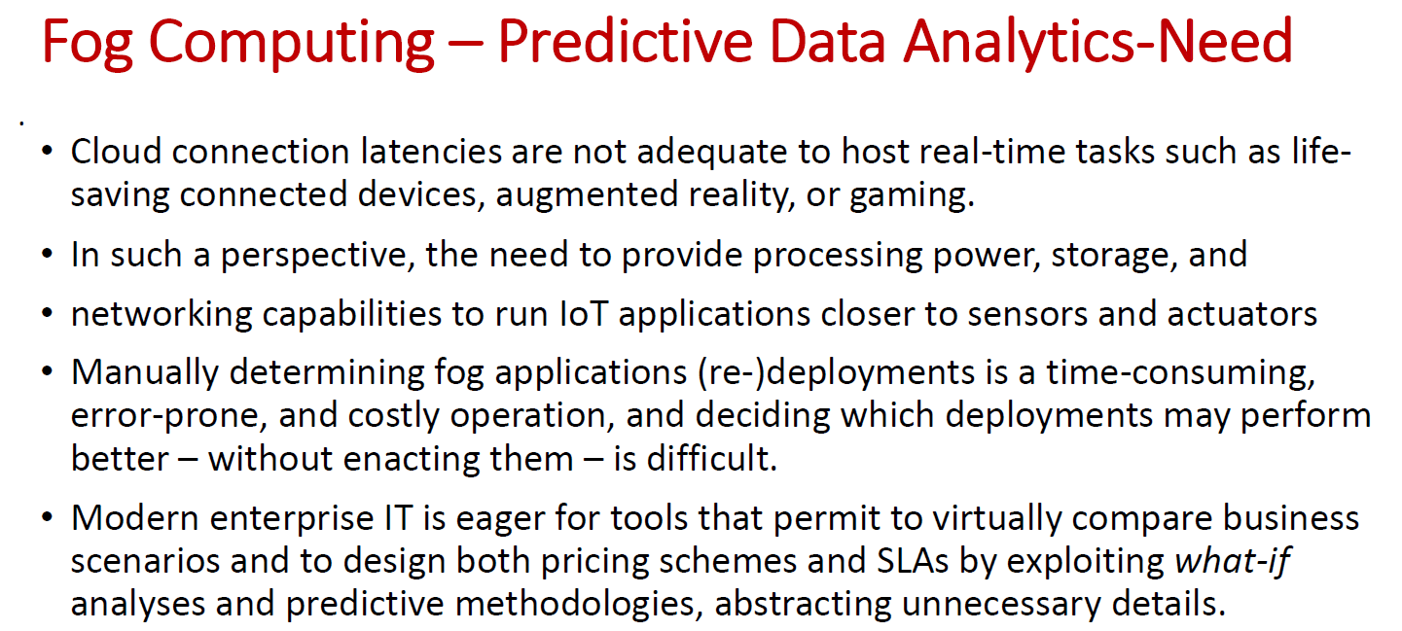

Slide 32
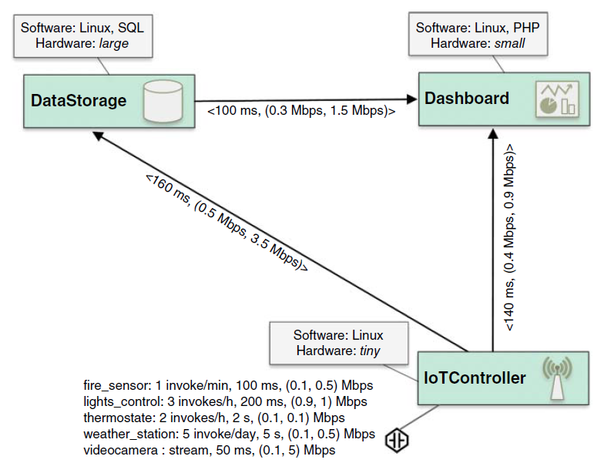
Smart Building
Consider a simple fog application shown below that manages fire alarm, heating and air conditioning systems, interior lighting, and security cameras of a smart building. The application consists of three microservices:
1. IoTController, interacting with the connected cyber-physical systems,
2. DataStorage, storing all sensed information for future use and employing machine learning techniques to update sense-act rules of the IoTController so to optimize heating and lighting management based on previous experience and/or on people behavior, and
3. Dashboard, aggregating and visualizing collected data and videos, as well as allowing users to interact with the system.

Slide 33
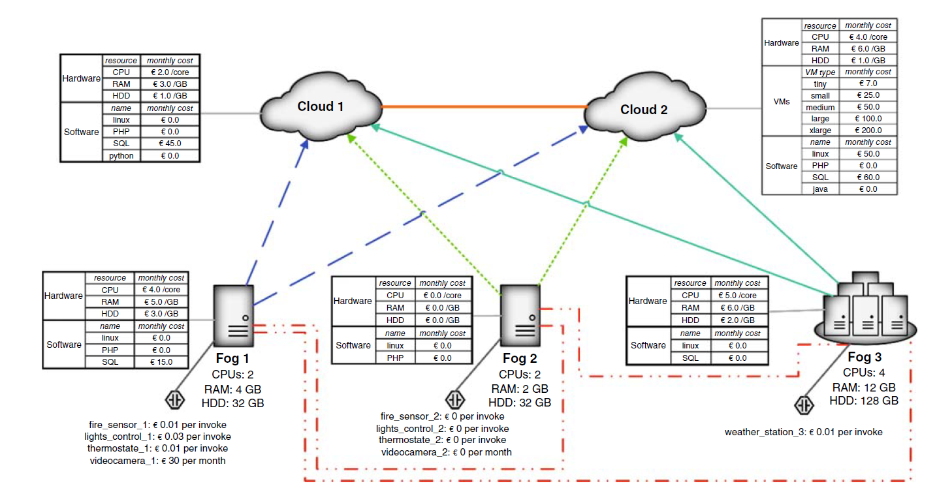

Slide 34
FogTorch𝚷
FogTorch𝚷 is an extended version of FogTorch, designed to support predictive analysis for fog application deployment
It incorporates probabilistic models and algorithms to estimate resource consumption and QoS (Quality of Service) assurance for eligible deployments
Key Features
Probabilistic Analysis: Estimates the likelihood of various outcomes based on historical data and current conditions.
Resource Estimation: Predicts the computational and energy resources required for deploying fog applications.
Monte Carlo Simulation: Runs multiple simulations to predict deployment costs and performance under different scenarios

Slide 35
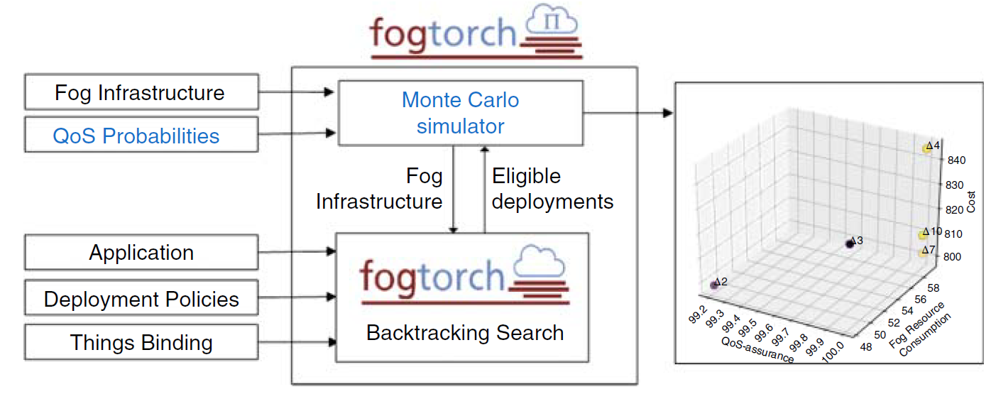
Predictive Analysis with FogTorch𝚷
Modeling Applications and Infrastructures

Slide 36
FogTorchΠ input consists of the following:
1. Infrastructure I. The input includes a description of an infrastructure I specifying the IoT devices, the fog nodes, and the cloud data centers available for application deployment (each with its hardware and software capabilities), along with the probability distributions of the QoS (viz., latency, bandwidth) featured by the available (cloud-to-fog, fog-to-fog and fog-to-things) end-to-end communication links6 and cost for purchasing sensed data and for cloud/fog virtual instances.
2. Multicomponent application A. This specifies all hardware (e.g., CPU, RAM, storage), software (e.g., OS, libraries, frameworks) and IoT requirements (e.g., which type of things to exploit) of each component of the application, and the QoS (i.e., latency and bandwidth) needed to adequately support component–component and component–thing interactions once the application has been deployed.
3. Things binding 𝝑.This maps each IoT requirement of an application component to an actual thing available in I.
4. Deployment policy 𝜹.The deployment policy white-lists the nodes where A components can be deployed7 according to security or business-related constraints.

Slide 37
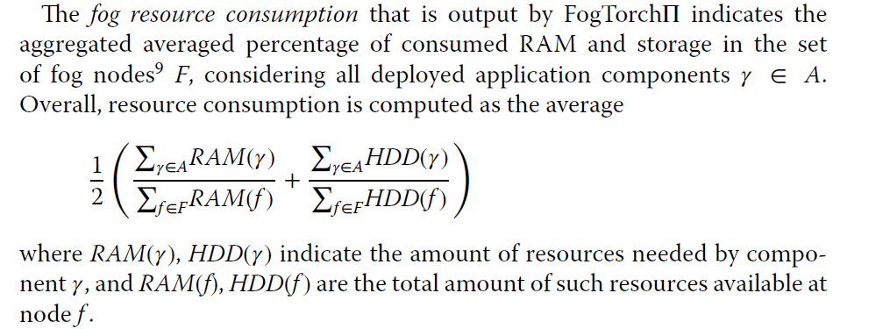
Estimating Resource Consumption and Cost

Slide 38
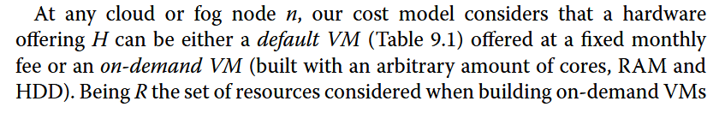
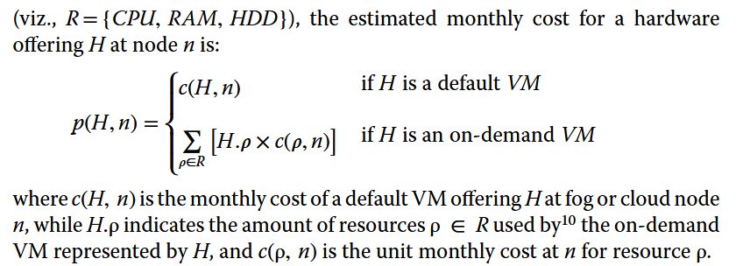

Slide 39

Machine Learning in Fog Computing
There are multiple issues with a cloud-only architecture where data from IoT devices make it to the cloud to be processed and analyzed:
i) Network traffic congestion.
By 2030, there will be over 100 billion things connected to the Internet, and if processing of the data happens in the cloud, there would be a network congestion and data may not get to the server and back fast enough.

Slide 40
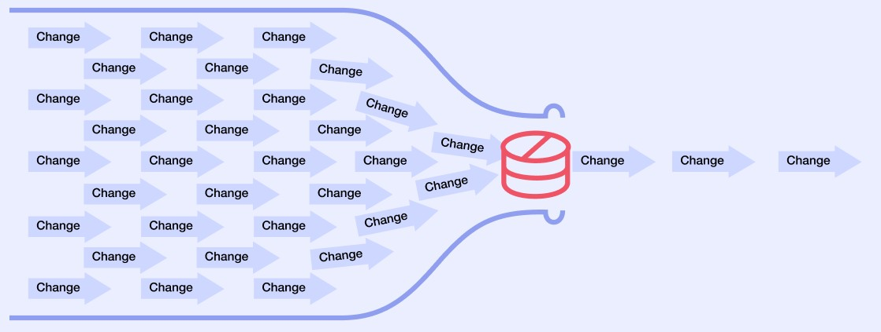
ii) Data bottleneck.
If data storage and analysis is done only in the cloud, there could be a bottleneck if the server is slower in analyzing due to the volume of the data or for other reasons.
iii) Security issues.
Since data must travel through multiple layers from sensors to gateways
to services to the cloud, there are numerous points of a breach.
A security solution in the cloud may address issues that are common to most devices and may not be able to take care of specific sensors or nodes on the edge.

Slide 41
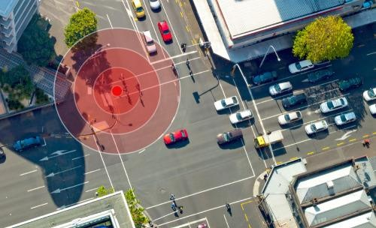
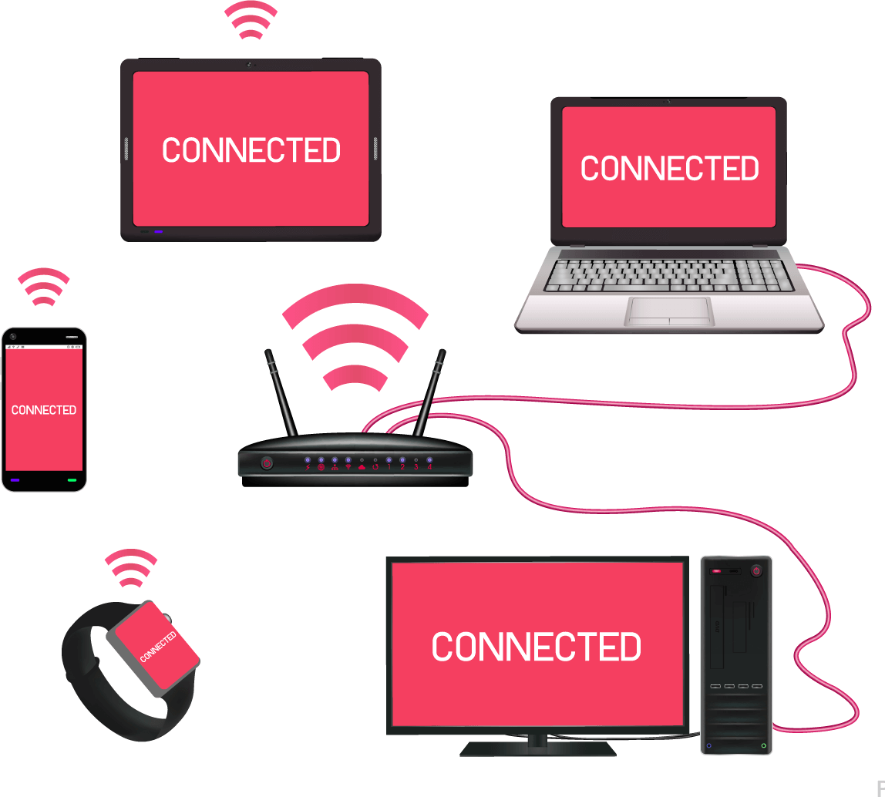
iv) Data staleness.
In many instances, data loses its value when it cannot be analyzed fast
enough.
Security cameras, phones, cars, ATMs, and so forth, could generate data that need immediate analysis if there is a security or a privacy issue.
Fog computing solves this by selectively moving compute, storage, and decision-making closer to the network edge where data are being generated.
Essential characteristics of fog computing platforms include low latency, location awareness, and wired or wireless access.

Slide 42
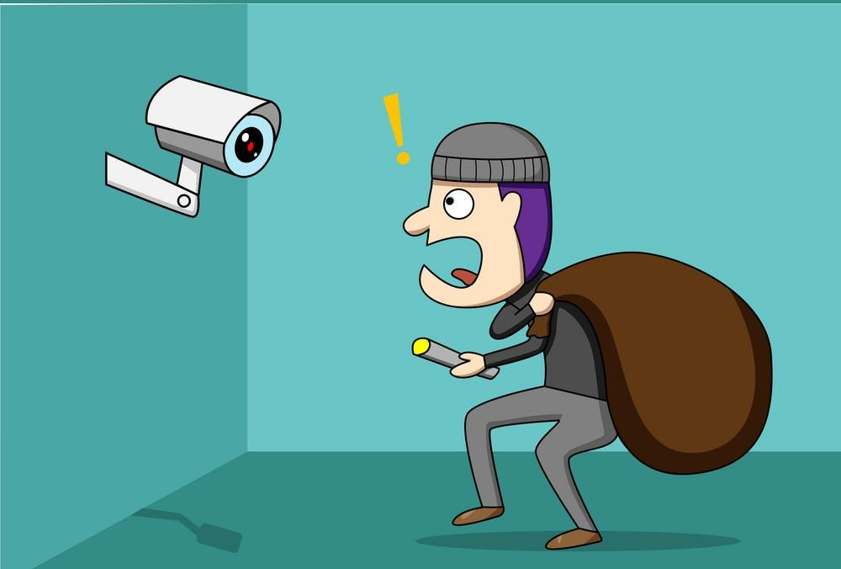

There are numerous benefits of fog computing as follow:
i) Real-time analytics.
As IoT usage grows, the number of scenarios where real-time analytics is needed occurs too often (e.g. security camera capturing a potential intruder loitering in front of a home or a fraudster gaining access to someone’s account).
By the time data get uploaded to the cloud and get analyzed; it may be
too late.
These scenarios need near-instant intelligence that fog computing
provides.

Slide 43
ii) Improved security.
Since fog is nearer to the edge, it has the capability to configure security
that is tailored to the devices and their functions.
Also, security decisions regarding whether to block access during a breach can be taken almost instantaneously.
iii) Data thinning at the edge.
Fog consumes the raw data and makes decisions or provides insights.
It sends only relevant, consolidated information upward in the hierarchy.
This dramatically reduces the amount of data that gets transmitted to a
central data center.
iv) Cost savings.
Fog may have higher setup costs due to distributed nature of deployments, but operational costs and long-term benefits of the overall system would outweigh this.

Slide 44
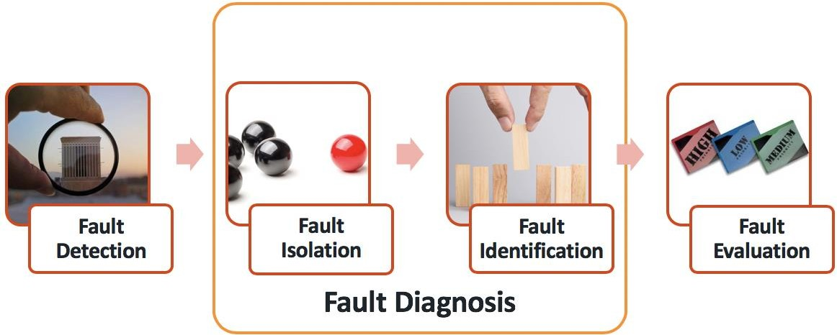
A. Machine Learning for Fog Computing and Security
One of the main advantages of fog computing is the ability to do near real-time analytics, and in many cases, this means utilizing machine learning at the fog nodes.
Machine learning used in industries could help in fault isolation and fault detection of machines and thus improve MTTR (mean time to repair) of failed system to achieve higher availability.
At the fog nodes, analytics can be both reactive as well as predictive.
The fog nodes closer to the edge will most likely have reactive analytics, and the nodes farther from the edge will have more predictive analytics since it needs more computation power.
The basic premise is that computing power is highest in the cloud and it
goes down in the hierarchy on n-tier architecture

Slide 45
Reactive Analytics
Realtime Monitoring: Fog nodes can immediately analyze incoming data and respond to events as they happen. For example, in smart agriculture, if a sensor detects that soil moisture has dropped below a certain threshold, the fog node can instantly trigger the irrigation system.
Event Detection: Quickly identifies anomalies or specific conditions that require immediate action, such as overheating in industrial machinery or unauthorized access in a security system.
Predictive Analytics
Trend Analysis: By continuously monitoring data trends, fog nodes can predict future events. For instance, in healthcare, analyzing trends in patient vital signs can predict potential health issues before they become critical.
Preventive Maintenance: In industrial settings, predictive models can forecast when machinery is likely to fail, allowing for maintenance to be scheduled before a breakdown occurs. This reduces downtime and maintenance costs.

Slide 46
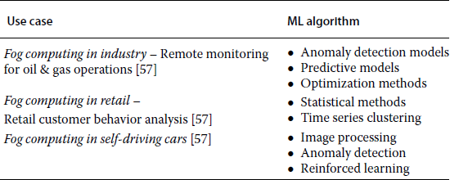
Machine-learning algorithms can be run at fog nodes that have the
processing power to compute corresponding to the task at that layer .
Machine-learning models are created at the nodes near the cloud or in the cloud itself.
The models could be downloaded to middle-tier nodes to help in execution.

Slide 47
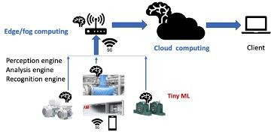
B. Examples of Machine Learning in Fog Computing
i) ML in Fog Computing Industry
Traditional cloud-based or non cloud centralized analytics infrastructures rely on training a machine learning algorithm by using data from past failures.
The algorithm would create a model that could be used to predict failure.
But in many instances, failure prediction is too late to prevent the
breakdown and is used to minimize the effect of damage.
In comparison, if near-instant analytics is done locally using fog computing, the system would be able to take steps to prevent the occurrence of the issue.
That is because the analytics system is nearer to the edge and has more context.

Slide 48
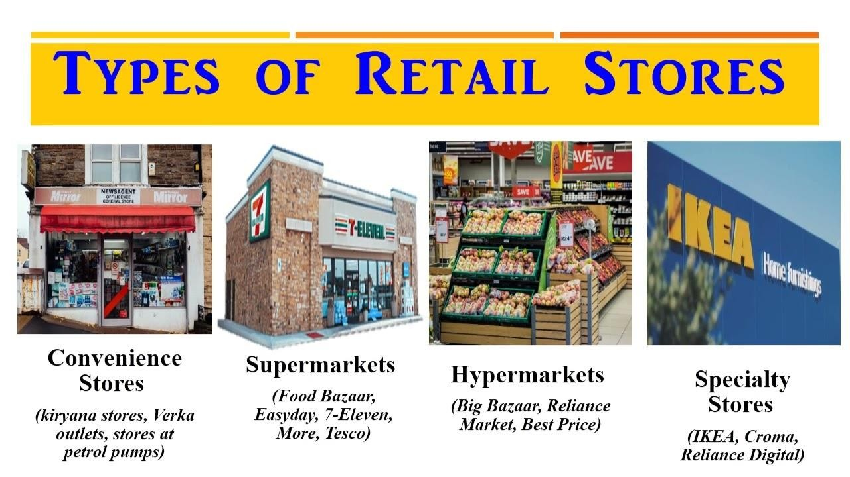
ii) ML in Fog Computing in Retail
Retail stores, in general, do product placement based on analytics
derived from customer purchases and also seasonal preferences.
We see product placements change during Halloween, Thanksgiving, Christmas, and so forth.
If fog computing is used with analytics being done for a store or a group of stores in an area, the system would be able to analyze buying patterns of the users in the locality and help the store to target merchandise better and improve customer experience.

Slide 49
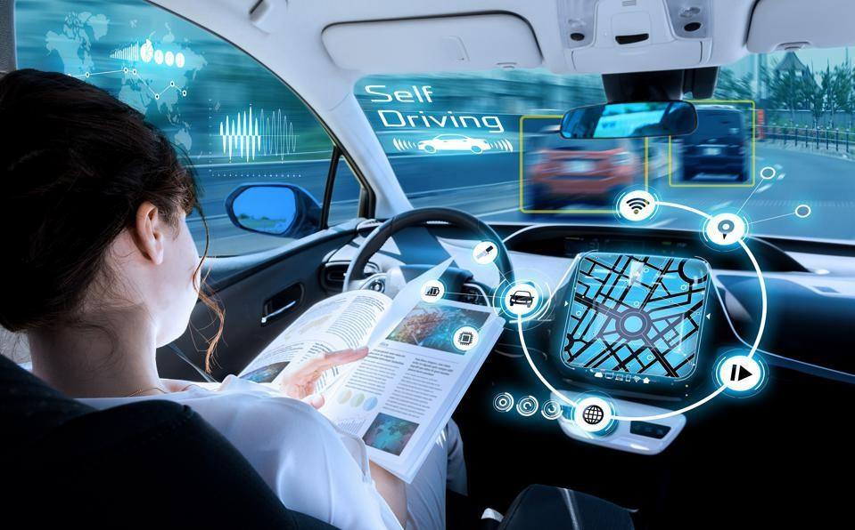
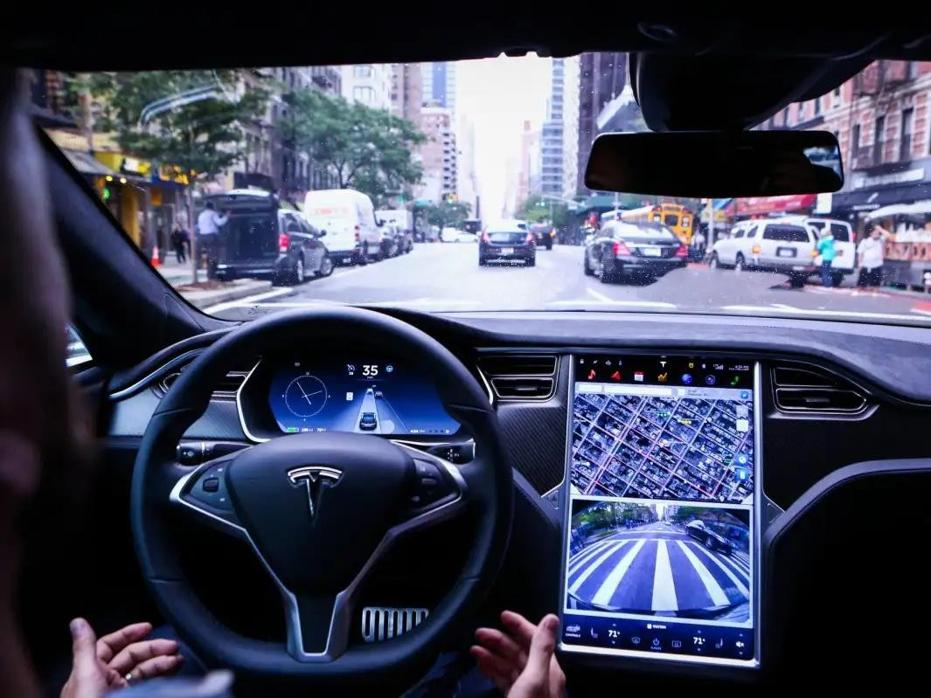
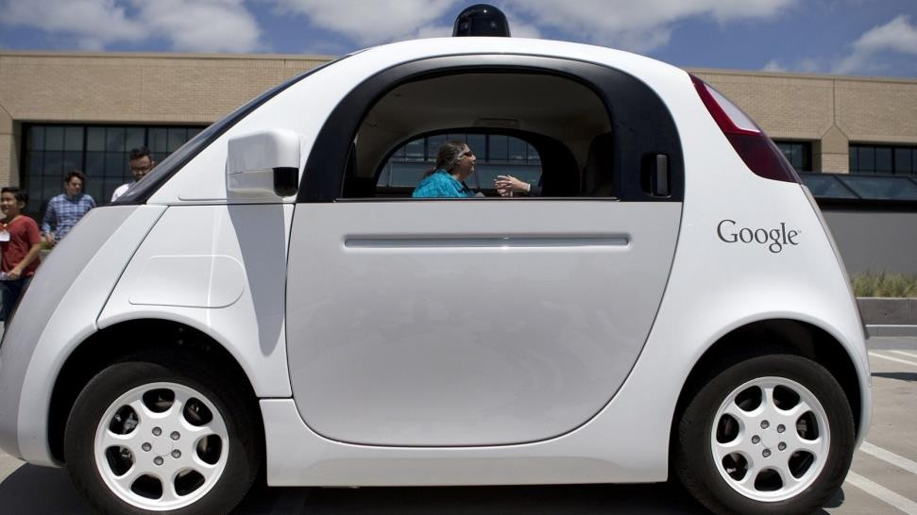
iii) Fog Computing for Self-Driving Cars
Self-driving automobiles are excellent examples of fog computing, since
a lot of computing and decision-making happens on the edge.

Slide 50
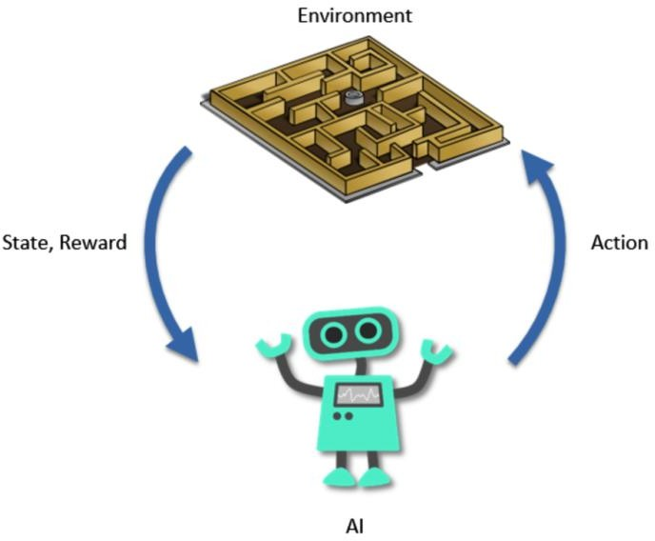
Each car transmits a lot of data for processing in the cloud.
An N-tier model would make the system considerably more efficient.
Machine-learning algorithms used are
ANN for image processing
Naïve Bayes or similar algorithms for anomaly detection, reinforced learning.

Slide 51
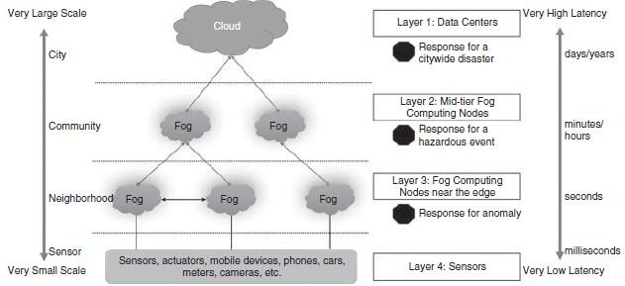
c. Machine Learning in Fog Computing Security
Tang et al. presented a hierarchical structure for fog
computing
architecture to support the integration of massive number of
infrastructure components and services in future smart cities.
The architecture laid out in the paper is a four-layer model, with the first layer being the cloud and the last being the sensors.

Slide 52
Layer 3 contains fog nodes that get raw data from the sensors.
The nodes at this layer perform two functions.
One identifies potential threat patterns on the incoming data streams from sensors using machine-learning algorithms.
The other performs feature extraction for reducing the amount of data to be sent upstream.
Algorithms like KNN, Naïve Bayes, random forests, or DBSCAN could
be used to do anomaly detection.
Layer 2 contains fog nodes that get data from nodes below them, and the data represent information from hundreds of sensors across locations.
In the paper, HMM (hidden Markov model) and MAP (maximum aposteriori) algorithms are used for classification and alert if there is a hazardous event.

Slide 53
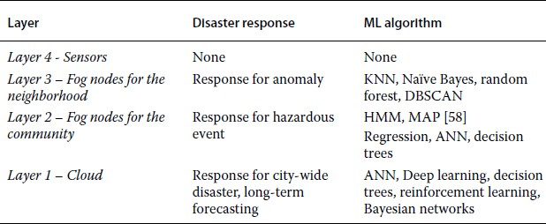
Machine-learning algorithms at different fog layers.

